Slide 1
Research Progress
Last week of December 2023, through jan 1st ; till 8th of January.

Slide 2
Dataset Selection & Methodology Selection
EEG Dataset was observed in edf file format
Use of EEGLAB within MATLAB to learn to interpret the EEG signal Data of subjects (on a singular session basis) was started to be done.

Slide 3
Power Spectrum
It gives the maximum frequencies across time.
Y axis as Log Power Spectral Density X axis as Frequency
Log X vs X scale type is observed.
MATLAB – eeglab was used.

Slide 4
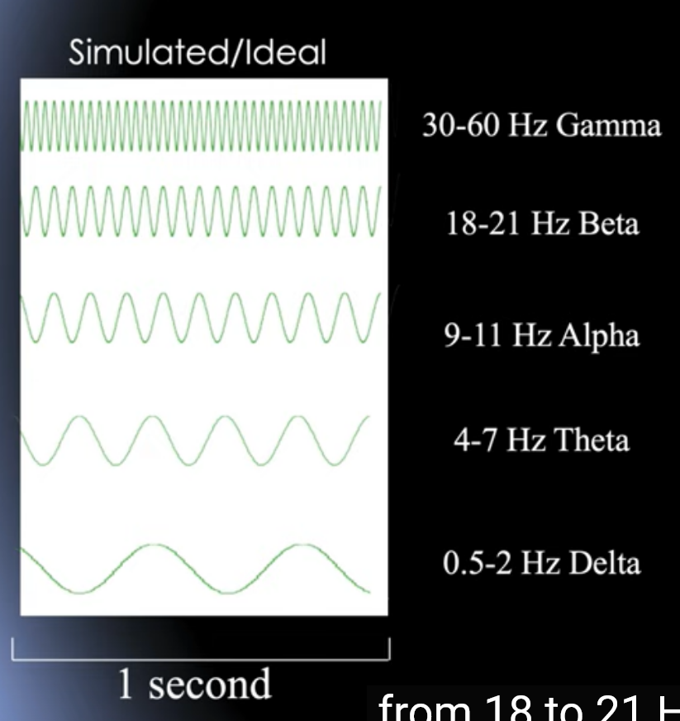
Classification of EEG signal waves by frequency.
Ideal Waves are classified by their frequency as follows
NREM sleep ( Stage 1 ) is dictated by presence of Alpha and theta waves.
. The early portion of stage 1 sleep produces alpha waves, which are relatively low frequency (8–13Hz), high amplitude patterns of electrical activity (waves) that become synchronized
Source - https://digitaleditions.library.dal.ca/intropsychneuro/chapter/stages-of-sleep/
https://jcsm.aasm.org/doi/10.5664/jcsm.26814

Slide 5
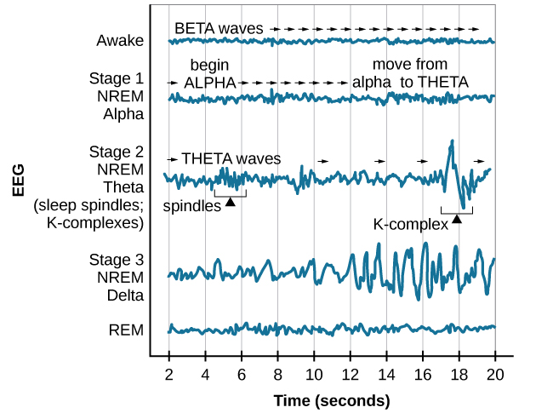
Classification of sleepEEG signal waves by frequency.
This pattern of brain wave activity resembles that of someone who is very relaxed, yet awake. As an individual continues through stage 1 sleep, there is an increase in theta wave activity. Theta waves are even lower frequency (4–7 Hz), higher amplitude brain waves than alpha waves. It is relatively easy to wake someone from stage 1 sleep; in fact, people often report that they have not been asleep if they are awoken during stage 1 sleep.
Source - https://openstax.org/books/psychology-2e/pages/4-3-stages-of-sleep#Figure_04_03_Stages

Slide 6
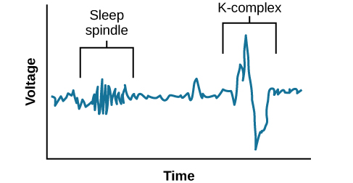
Classification of EEG signal waves by frequency.
move into stage 2 sleep, the body goes into a state of deep relaxation. Theta waves still dominate the activity of the brain, but they are interrupted by brief bursts of activity known as sleep spindles
A sleep spindle is a rapid burst of higher frequency brain waves that may be important for learning and memory
In addition, the appearance of K-complexes is often associated with stage 2 sleep. A K-complex is a very high amplitude pattern of brain activity that may in some cases occur in response to environmental stimuli. Thus, K-complexes might serve as a bridge to higher levels of arousal in response to what is going on in our environments
Source - https://openstax.org/books/psychology-2e/pages/4-3-stages-of-sleep#Figure_04_03_Stage2 (diagram)
https://pubmed.ncbi.nlm.nih.gov/9751278/ (EKG of sleep delta waves)
https://pubmed.ncbi.nlm.nih.gov/21075230/ (Cognitive Neuroscience of Brain)
https://pubmed.ncbi.nlm.nih.gov/21167865/ (Sleep Spindle paper)

Slide 7
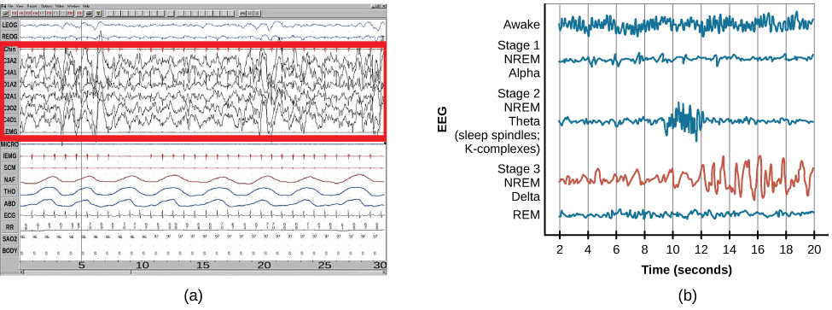
Classification of EEG signal waves by frequency.
Stage 3 is often referred to as deep sleep or slow-wave sleep because this stage is characterized by low frequency (less than 3 Hz), high amplitude delta waves
Source - https://openstax.org/books/psychology-2e/pages/4-3-stages-of-sleep#Figure_04_03_Stage2 (diagram)
https://pubmed.ncbi.nlm.nih.gov/9751278/ (EKG of sleep delta waves paper)
https://pubmed.ncbi.nlm.nih.gov/21075230/ (Cognitive Neuroscience of Brain paper)
https://pubmed.ncbi.nlm.nih.gov/21167865/ (Sleep Spindle paper)

Slide 8
Classification of EEG signal waves by frequency.
During this time, an individual’s heart rate and respiration slow dramatically. It is much more difficult to awaken someone from sleep during stage 3 than during earlier stages. Interestingly, individuals who have increased levels of alpha brain wave activity (more often associated with wakefulness and transition into stage 1 sleep) during stage 3 often report that they do not feel refreshed upon waking, regardless of how long they slept
Source : https://pubmed.ncbi.nlm.nih.gov/18539057/ (nonrestorative Sleep paper)

Slide 9
Looking at our subjects

Slide 10
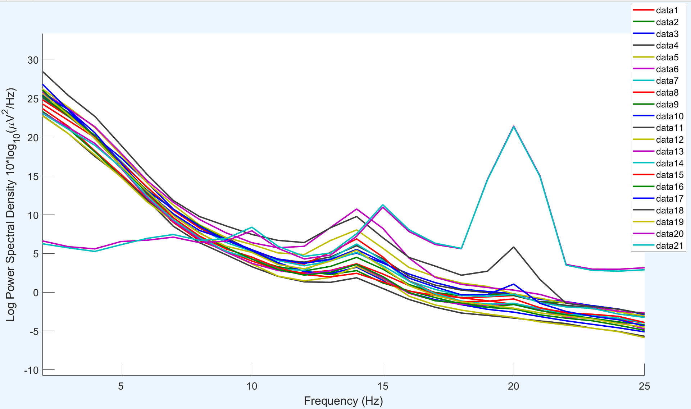
Subject 1
Peaks at 14 hz, 20 hz. Alpha and Beta Waves observed.
High Incidence of Delta Waves and Stage 3 Sleep ( Left height )
This is a “ Welsh Plot,” essentially a Histogram of observed Frequencies.
Power is Amplitude Squared.
Gyrus shows gamma activity

Slide 11
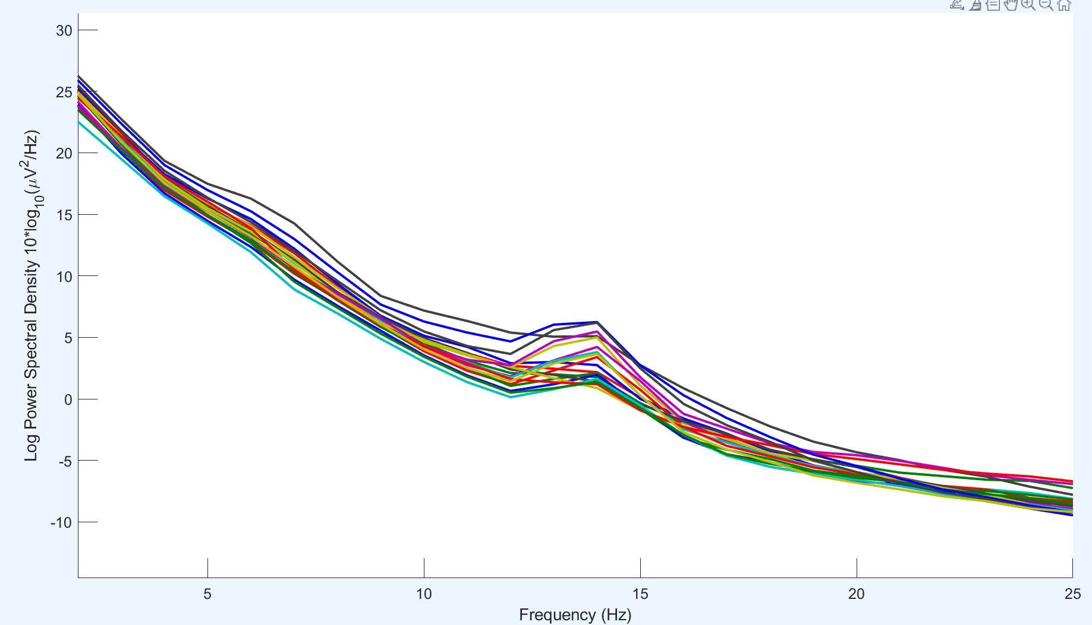
Subject 3
Peaks at 14 hz, Alpha anWaves observed.
High Incidence of Delta and Theta Waves and Stage 3 Sleep ( Left height ) This Differs from Adult Active Brain
This is a “ Welsh Plot,” essentially a Histogram of observed Frequencies.
Power is Amplitude Squared.

Slide 12
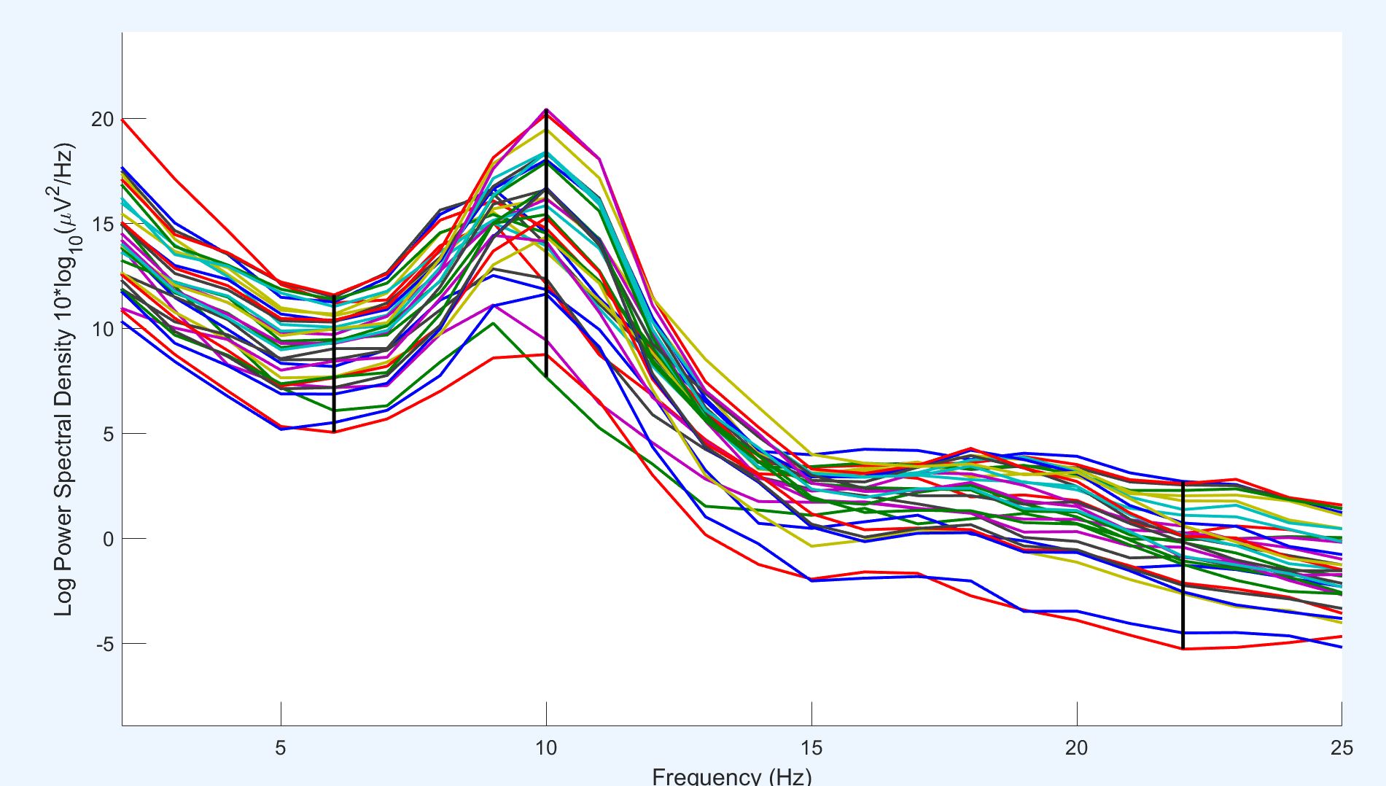
Adult Sleeping Brain ( EEGLAB – Sample Dataset)
Peak height at 10 Hz. Alpha Region of Light Stage 1 Sleep.
Incidence of Gamma region is higher.
Adults Have Sleep with more Alpha Regions; Babies sleep in Deep Sleep for more incident time

Slide 13
Drawbacks
The prior analysis is for the data as a whole; it is not a time based analysis.
Looking at Same time chunk data is more helpful possibly.

Slide 14
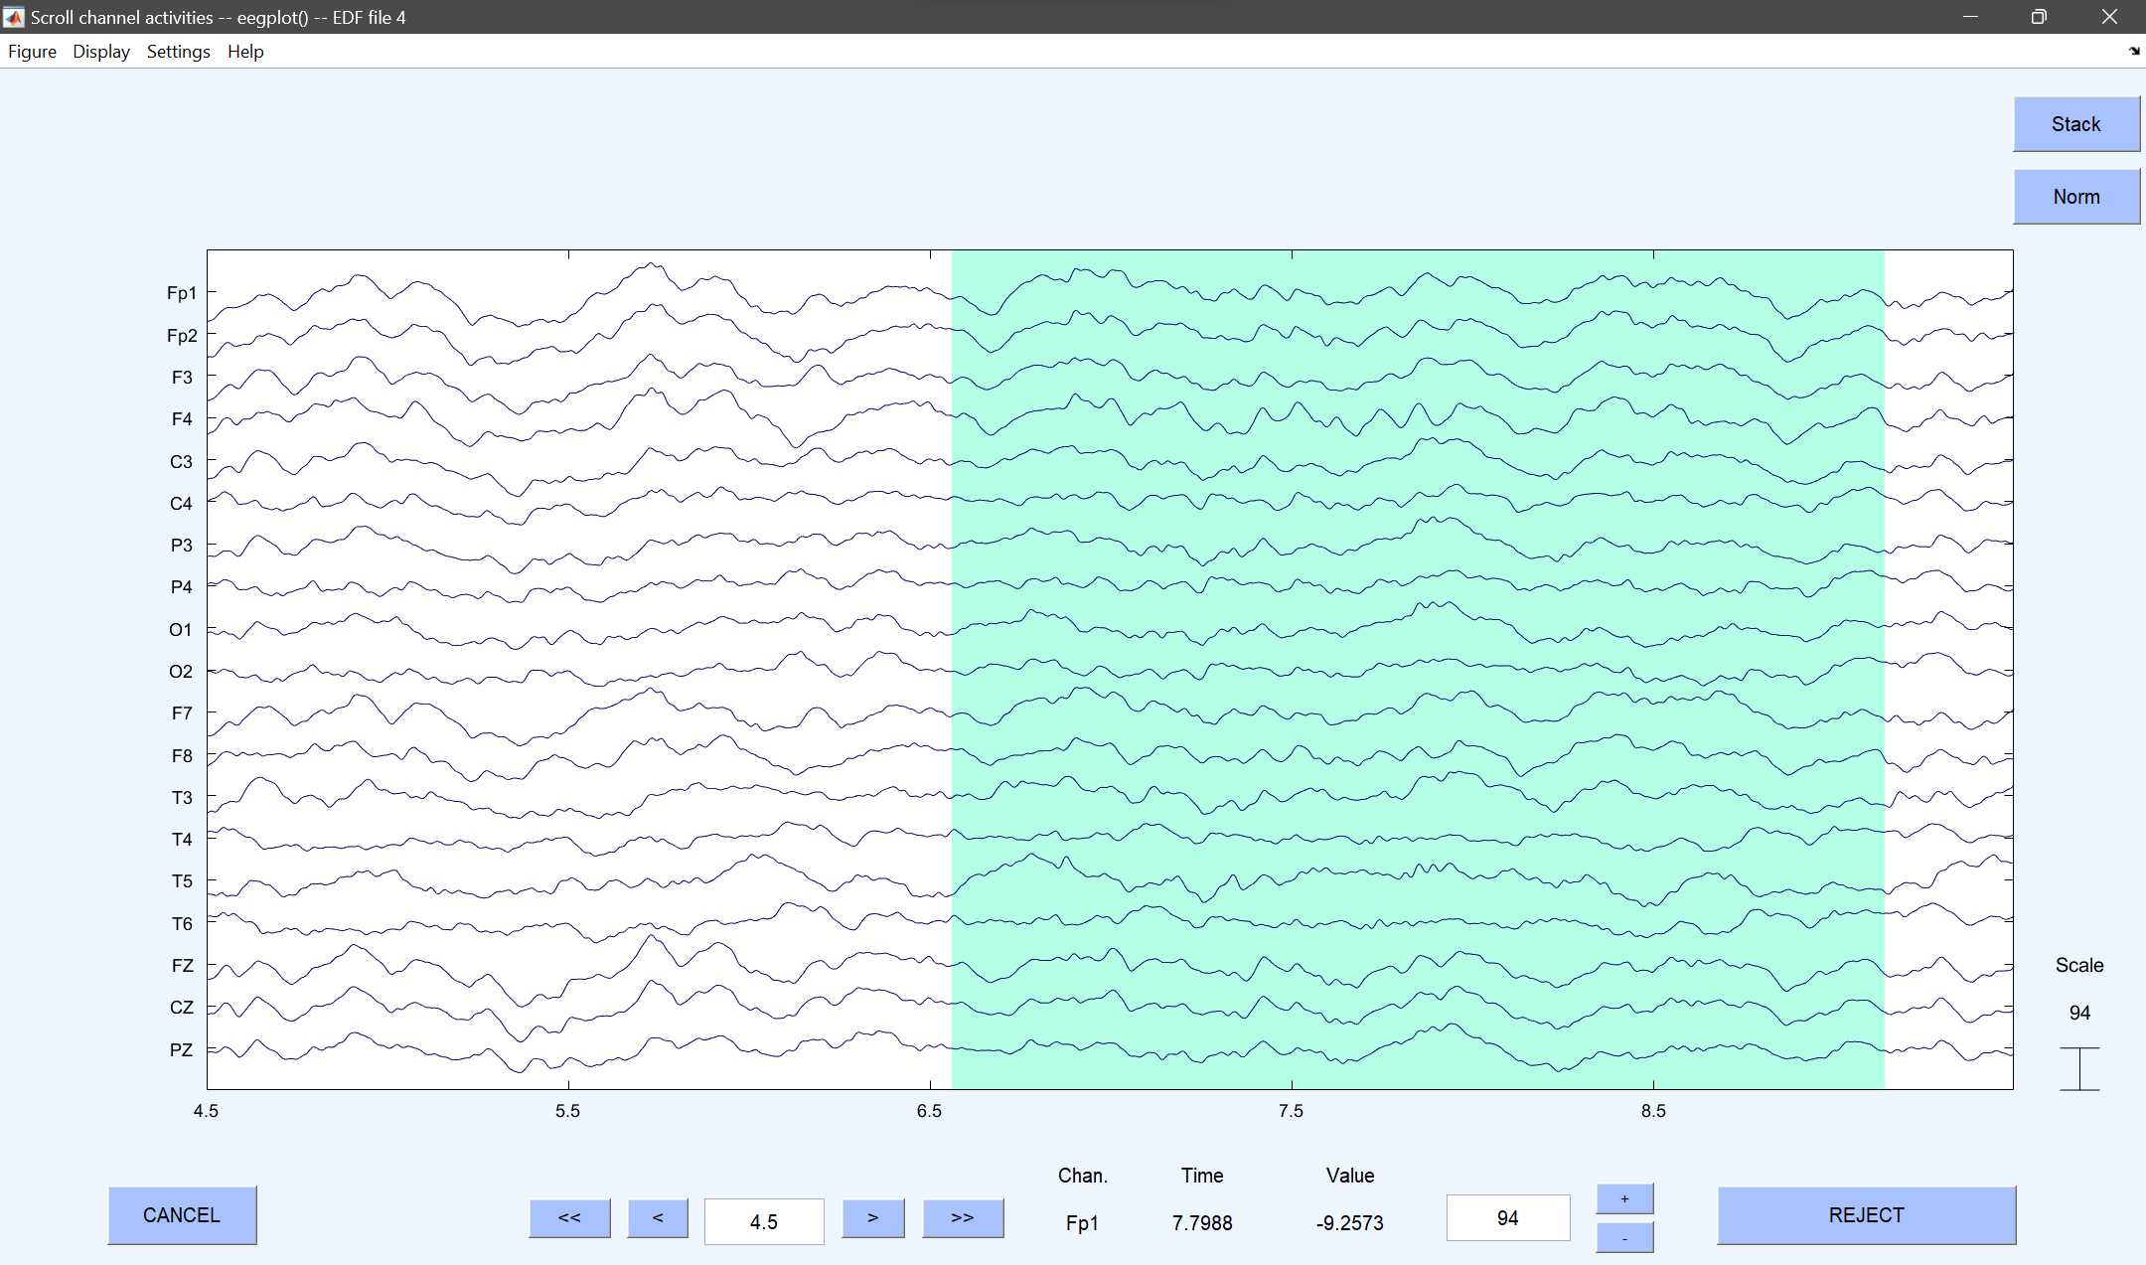
Looking at the EEG spectra channel data on its own – S3 – Annotated Region 1
Annotated Region as per dataset; eyes closed (onset at 6.545 , Region of 2.46 second)
Channel F4 shows K – Complex activity and NREM stage 3 sleep
Channel T5 shows NREM Stage 2 Sleep.

Slide 15
Further Directions
Create Sleep Stage Multitapers and compare Adult Sleep with Baby Sleep with Sleep stage incidence.
Feedback requested.

Slide 16
Methodology Breakdown - 1
To recreate the results from the selected research paper's methodology on EEG analysis,
EEG Epoch Selection:
Use the Selected 24 artifact-free, quasi-stationary EEG segments of 2.56 seconds each during physiologically quiet sleep, inspected visually by expert neurophysiologists, in the dataset.
Use 19-channel recordings, each epoch comprising 512 time points (5 ms sampling period).

Slide 17
Methodology Breakdown - 2
Unmixed Estimation of Primary Current at the Sources:
  Apply the unmixing algorithm described by Biscay et al. (2018) to linear inverse methods.
  This algorithm is effective for both single-source signals and multisource regions of interest (ROIs).
  Ensure the ROIs are disjointed and consider the electrode number limitation for unmixed signals.
  Code is Provided in Paper in MATLAB code. -> https://figshare.com/articles/code/unmixing_test_m/6223778

Slide 18
Meeting Notes
A transcript / Note of meetings

Slide 19
03-01-2024
Find a way to visualise an eeg signal.
Do Power Spectrum Analysis of all 21 channels of 1 subject’s one session

Slide 20
04-01-2024
Met and talked about bakups and reporting at the end of the sem.
Installed Matlab and EEGLAB.

Slide 21
06-01-2024
Did the visualisation for one subject, images attached after this.
Got to know how to do power spectra. Explored the topological maps (Colored Contour Heatmaps in 2d ) .
Reported.
Further directions received :

Slide 22
06-01-2024 (contd.)
Compare Infant Sleep Prominent Frequencies with the Individual Subjects
Ignore Lead 21 and 20
Get the Peaks, Find out what they signify, and How to find out a dominant Frequency from a EEG signal
Alpha, Beta , Band Fourier Domain Categorise the data REM vs Non REM data
Frequency and Power Spectra 4 subjects , Analyse Power Spectra
Check other papers, see how frequency changes correlate with changes in power spectra Frequencies and data of where what is SLEEP, NREM is what Sample data in EEGLAB.
identify and categorise regions of thepower spectra

Slide 23
08-01-2024 – Feedback received.
Generate Synthetic Timeseries Sinusoidal Data and record 1000 time points.
Keep Nyquist Theorem in mind when sampling.
Generate Welsh plots for this compound data.
Analyse this and understand what the meaning of the plot is. Give a write up.
Extract 21 channel data of annotated regions of 1 subject; concatenate and generate Welsh plots.
Write an analysis.
Report on 10-01-2024.
Read up on the 4 research papers. Make more slides. Write down the theory with references.

Slide 24
Ready Reference and Revision Notes
Materials and notes to refer to

Slide 25
Origin of the EEG
Made by Hans Burger.
An EEG signal originates as a Local Field on the surface of the brain when neurons fire together in a localised area.

